Slide 1
Ai object detection
CAPSTONE PROJECT
Presented By:
Student Name- Abhoy Sinha
College Name- School of Technology , North Eastern Hill University , Shillong
Department- Energy Engineering

Slide 2
OUTLINE
Problem Statement
Proposed System/Solution
System Development Approach
Algorithm & Deployment
Result
Conclusion
Future Scope
References

Slide 3
Problem Statement
In the modern digital era, machines must be able to interpret visual information in real time. However, traditional programs cannot automatically recognize objects from live camera feeds because they rely only on predefined instructions and lack visual intelligence.
Therefore, there is a need for an intelligent system capable of detecting and identifying objects automatically from a live video stream. The system should operate in real time, be lightweight, accessible through a web browser, and work across multiple devices without requiring complex installation or specialized hardware.

Slide 4
Proposed Solution
The proposed system is a real-time AI-based object detection web application that uses a pre-trained machine learning model to identify objects from a live camera feed.
The system captures video through the device camera, processes each frame using a lightweight deep learning model, and detects objects instantly.
Detected objects are highlighted with bounding boxes and labeled with confidence scores directly on the screen.
The application runs entirely in a web browser, making it platform-independent and accessible without installing additional software.
Adjustable controls such as AI toggle and FPS slider allow users to manage performance and detection speed.

Slide 5
System Approach
The system is developed using web technologies including HTML, CSS, and JavaScript for interface design and functionality.
The machine learning model is implemented using the ML5.js library, which provides a simplified interface for running deep learning models in the browser.
A pre-trained COCO-SSD object detection model is used to recognize common objects with high accuracy.
The application accesses the device camera through the WebRTC getUserMedia API to capture real-time video frames.
Each video frame is processed by the model, and detected objects are displayed with bounding boxes and confidence values on a canvas overlay.
The system runs entirely on the client side, ensuring fast processing, privacy, and no need for server computation.

Slide 6
Algorithm & Deployment
Algorithm Workflow:
Step 1: Initialize the pre-trained COCO-SSD object detection model. Step 2: Request camera access using browser media API. Step 3: Capture real-time video frames from the camera. Step 4: Pass each frame to the detection model. Step 5: Model analyzes image and predicts objects. Step 6: Draw bounding boxes and labels with confidence scores. Step 7: Repeat continuously for real-time detection.
Deployment Process:
The application is hosted using GitHub Pages for free web deployment.
All processing runs on the client side, eliminating server dependency.
Users can access the system through a browser using the hosted link.
The system works across devices including laptops and smartphones.

Slide 7
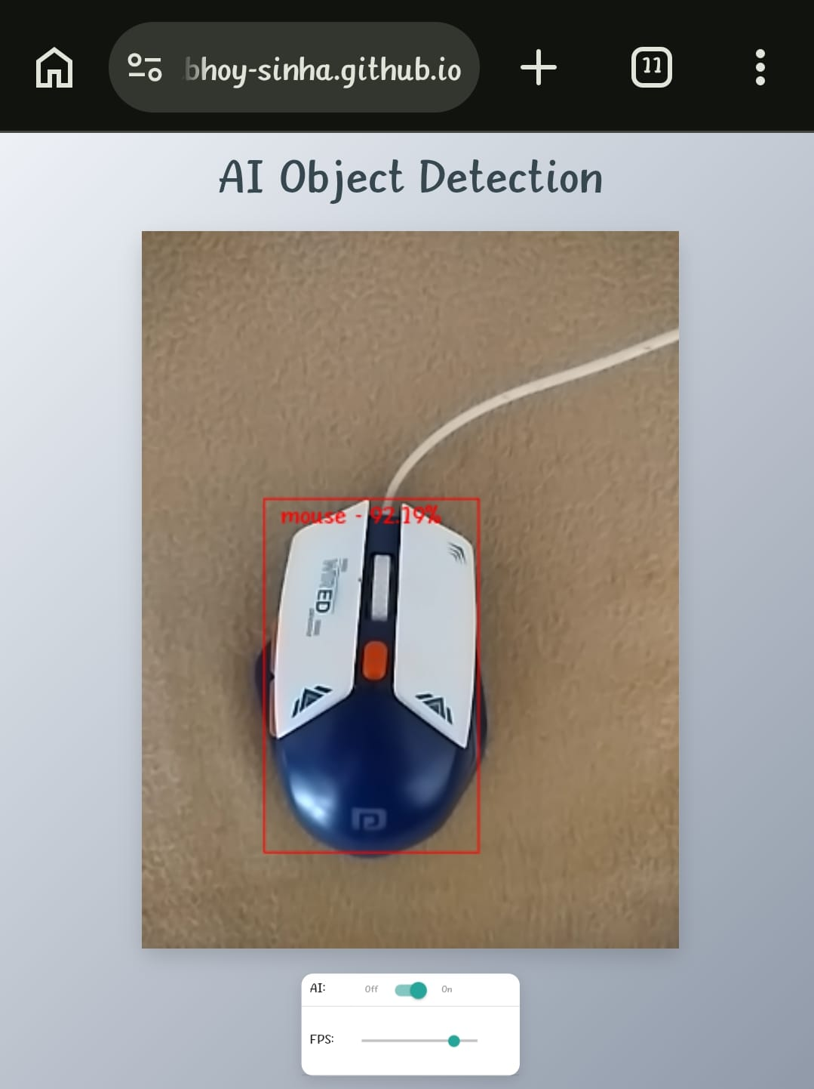
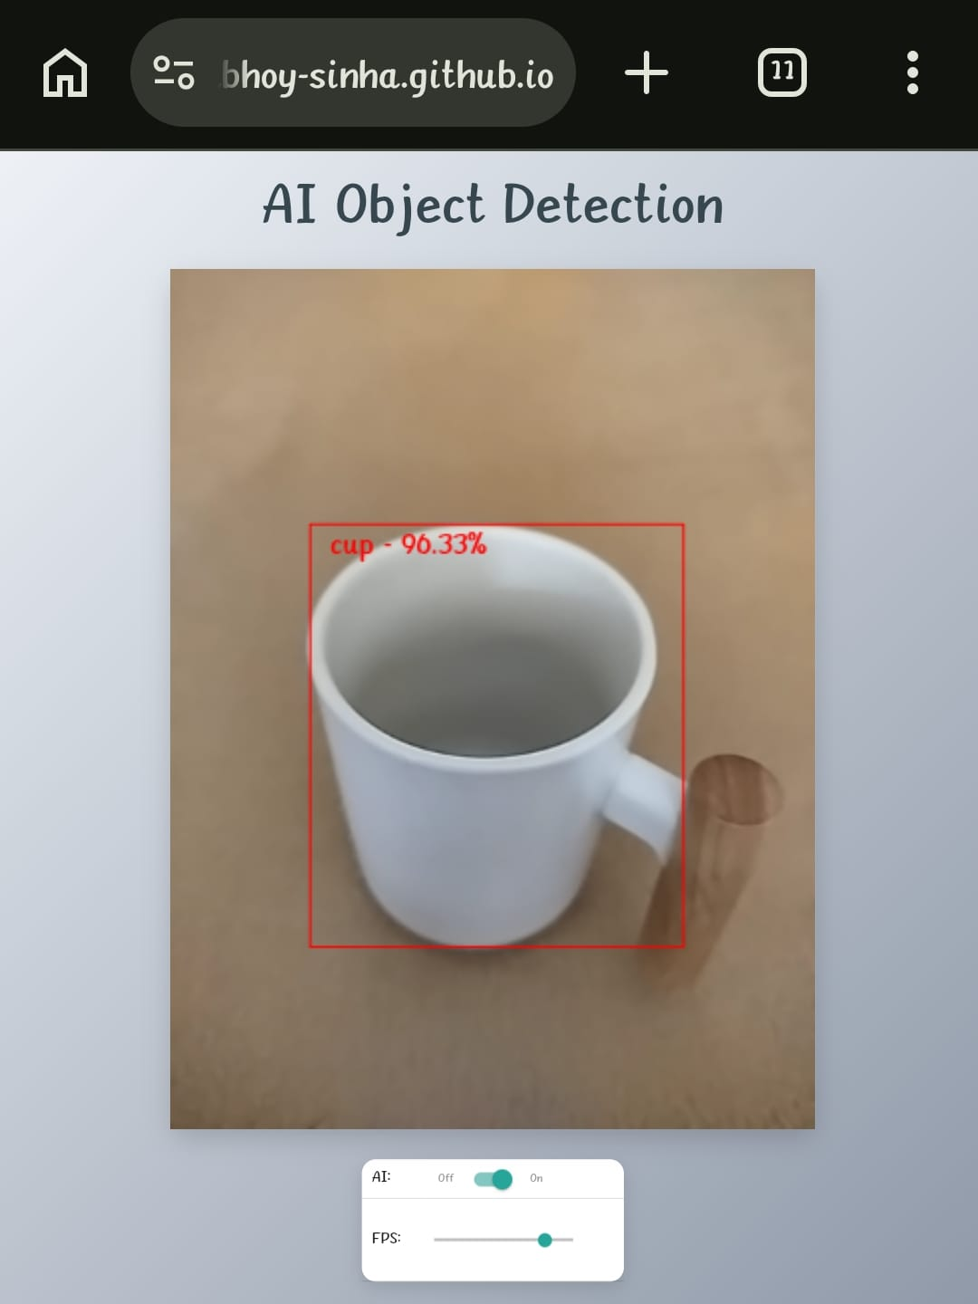
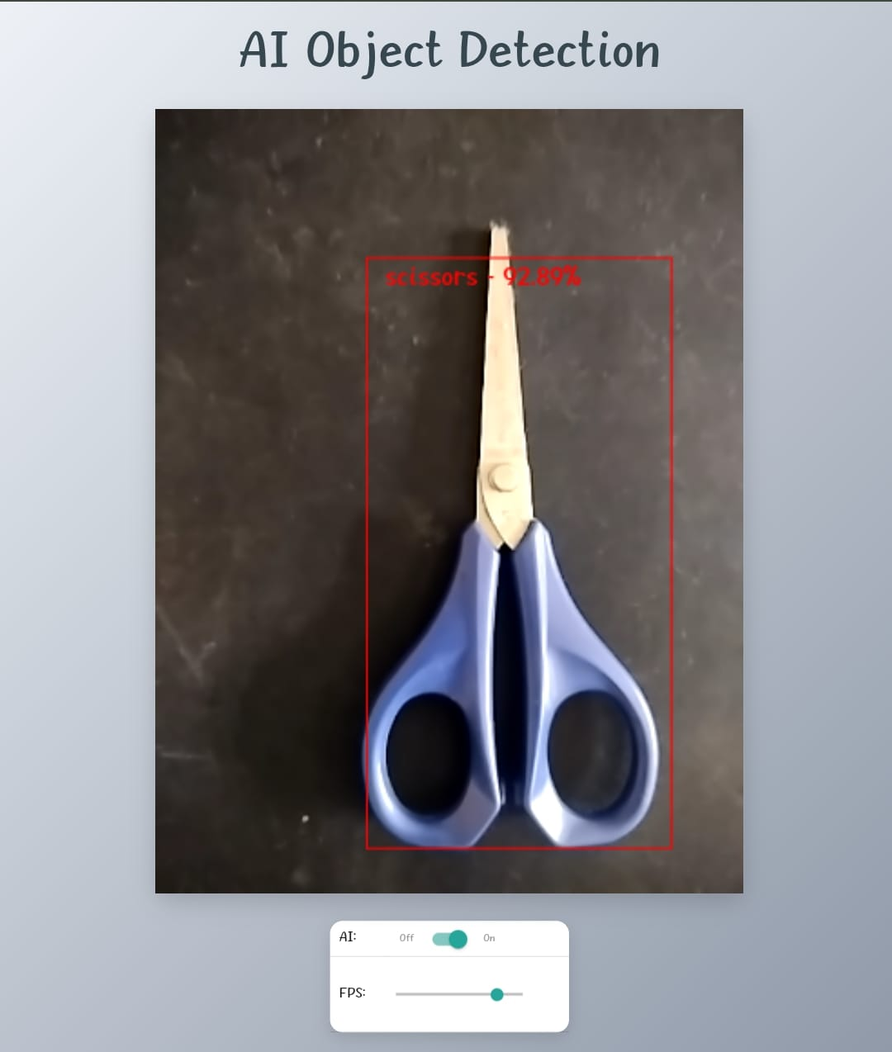
Result
The system successfully detects real-world objects in real time using a live camera feed. • Detected objects are highlighted with bounding boxes and confidence scores. • The model accurately identifies common objects such as mouse, scissors, cup, and person. • The application runs smoothly in a browser across different devices.

Slide 8
Conclusion
The developed AI object detection system successfully demonstrates real-time object recognition using a browser-based machine learning model.
The application is lightweight, efficient, and accessible across multiple devices without installation.
The system proves that modern web technologies combined with pre-trained AI models can create intelligent, real-time vision applications.
This project highlights the practical implementation of artificial intelligence in real-world scenarios.

Slide 9
Future scope
Integrate custom-trained models for specialized object detection.
Add voice alerts for detected objects to assist visually impaired users.
Implement object counting and tracking features.
Enhance accuracy using advanced deep learning models.
Extend the system for applications such as surveillance, smart monitoring, and automation.

Slide 10
References
• ML5.js Documentation — https://ml5js.org • TensorFlow Object Detection Model — https://tensorflow.org • COCO Dataset Research Paper — Lin et al., Microsoft Research • Mozilla Web API Documentation — https://developer.mozilla.org • GitHub Pages Documentation — https://docs.github.com
.

Slide 11
Github link
Github Link : https://github.com/abhoy-sinha/ai-object-detection
Deployment Link: https://abhoy-sinha.github.io/ai-object-detection/

Slide 12
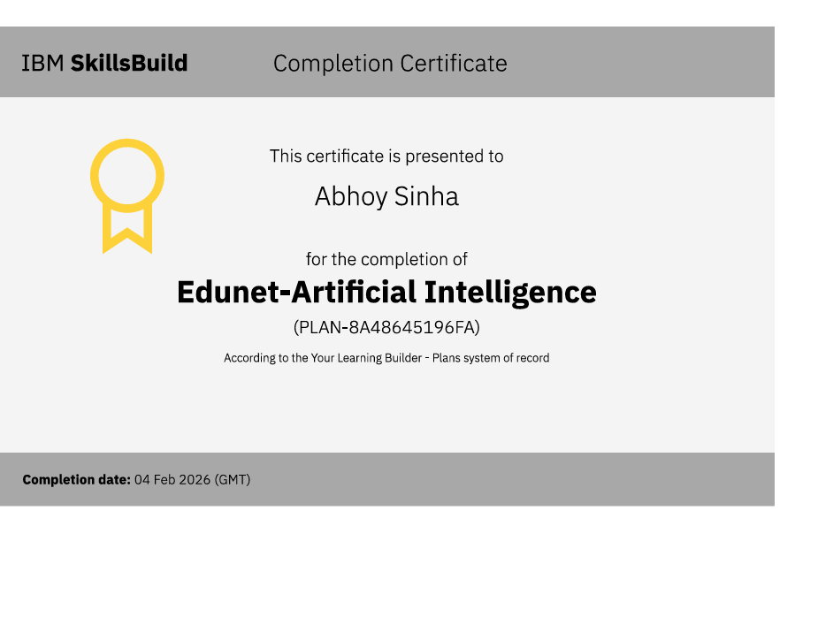
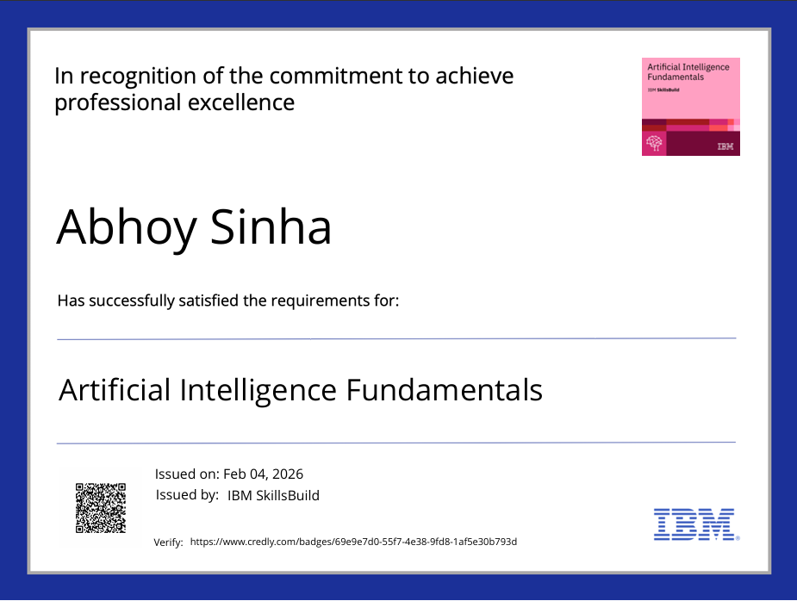
certificates

Slide 13
THANK YOU

